Slide 1

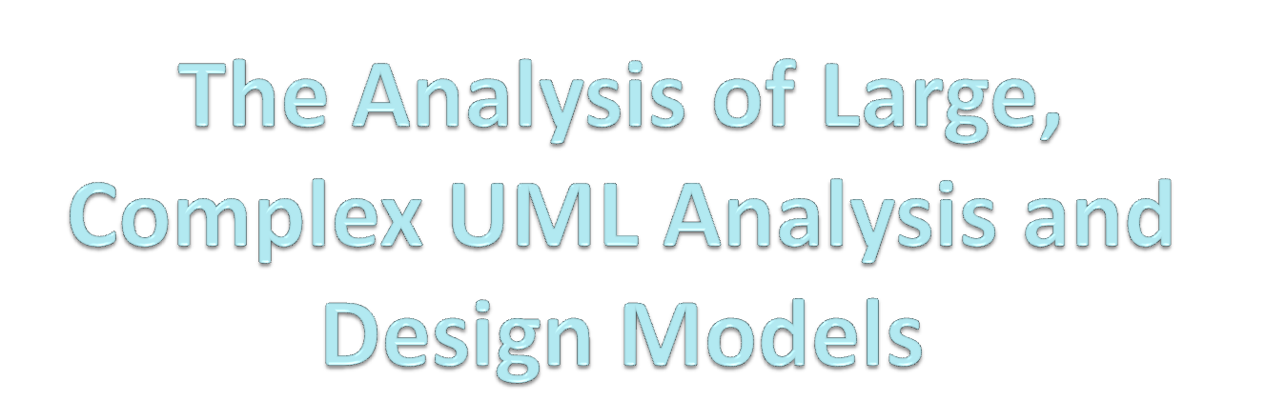
Paper written by Brian Berenbach
Presentation by Matthew Merricks

Slide 2


Currently manager of the
requirements engineering competency center at Siemens
Corporate Research
Extensive experience in requirements and product line requirements elicitation and management
Several years experience prior to joining Siemens as a software product line manager

Slide 3

2003 - Evaluating the Quality of a UML Business Model
2003 - The Automated Extraction of Requirements from UML Models
2004 - Comparison of UML and Text Based Requirements Engineering
2006 - Introduction to Product Line Requirements Engineering

Slide 4

The model should have a single entry point
The early model should cover the entire breadth of the domain
Identify out of scope use cases as early as possible
All the actors in the model should be shown on the context diagram
Every diagram should have an associated description and status
Avoid the early use of packages

Slide 5
Do not substitute packages for abstract use cases
Every artifact in a UML model should be a visible on a diagram
Every symbol should have a bi-directional hyper-link to the diagrams that define it
Package dependencies should be based on content

Slide 6

Every concrete use case must be defined
Use an activity diagram to show all possible scenarios associated with a use case
Use sequence rather than collaboration diagrams to define one thread/path for a process
Abstract use cases must ne realized with included or inheriting concrete use cases
The definition of a use case must be consistent across all diagrams defining the use case

Slide 7

Extending use case relationships can only exist between concrete use cases
A concrete use case cannot include an abstract use case

Slide 8

An interface class should derive from an analysis boundary class
Every class in the design model should trace back to a use case in the analysis model

Slide 9

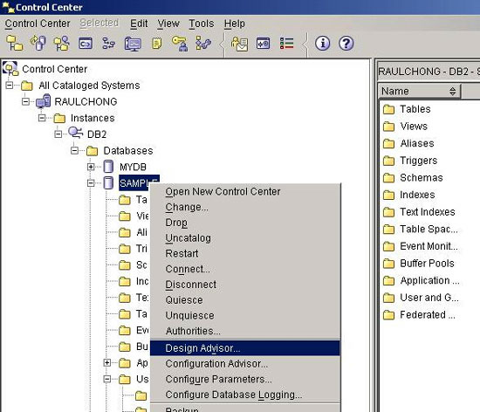
The Design Advisor tool was developed specifically to analyze and measure the “goodness” of large, complex UML models

Slide 10

Type | Analysis | Analysis Design | Analysis | Reversed Code | Design
Domain | Health | Transportation | Chemical | Transportation | Power
Classes | 384 | 1,105 | 243 | 1,570 | 1,104
Use Cases | 1,121 | 35 | 86 | 0 | 0
Total Errors | 7,014 | 21,144 | 2,243 | 5,319 | 11,733

Slide 11

Lack of Process contributed to a large number of errors
Lack of Quality Assurance led to a staggering number of errors
Those design models that derived from Analysis had fewer errors than models that originated as designs

Slide 12
Paper written by Brian Berenbach
Presentation by Matthew Merricks

